Slide 1
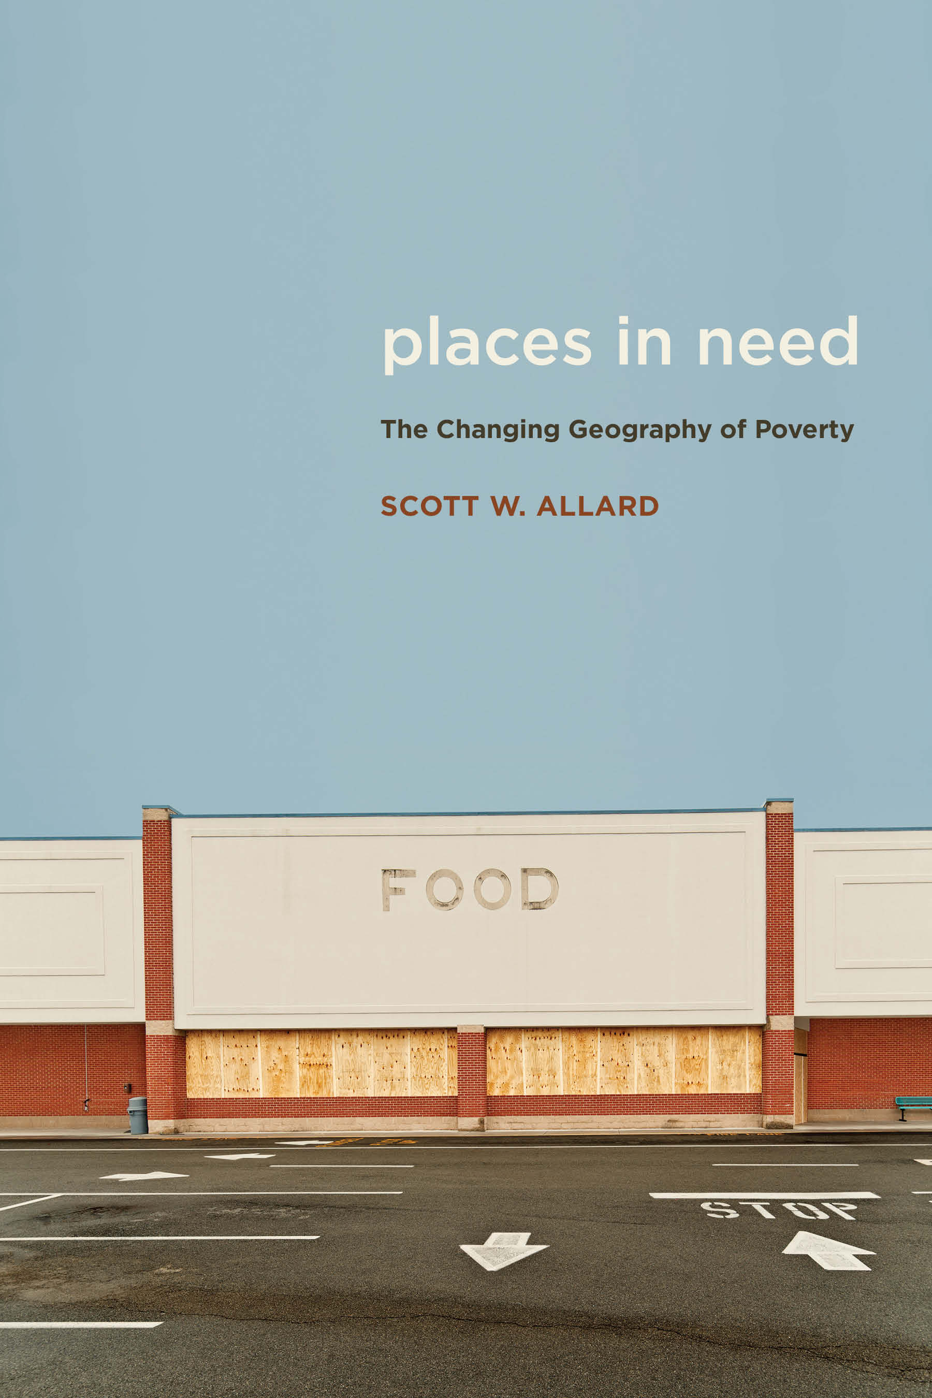
The Changing Geography of
Poverty in America
Scott W. Allard
Daniel J. Evans Endowed Professor
of Social Policy
Evans School of
Public Policy & Governance
University of Washington
sallard@uw.edu
@scottwallard
www.scottwallard.com
This project has received support from the Russell Sage Foundation, the Brookings Institution Metropolitan Policy Program, the Peterson and Ford Foundation’s US2050 Initiative, the University of Chicago, and the New York Community Trust.

Slide 2
Outline for Today
Conventional Thinking about Place & Poverty
Implications for Safety Net and Human Services
Changing Geography of Poverty
Implications for Safety Net & Policy
Pathways Ahead

Slide 3
Official Federal Poverty Measure
Federal poverty line (FPL) = threshold for poverty status
Based on 1955 food consumption which was 1/3 of typical family budget at the time
Income = cash income from nearly all sources in a year
Income unit = families & unrelated individuals
FPL Threshold = multiplied “economy food plan” by 3
Poverty status = family income below FPL
Poverty line for single parent, two kids = $19,749 annually
Poverty line for two parents, two kids = $24,858 annually

Slide 4
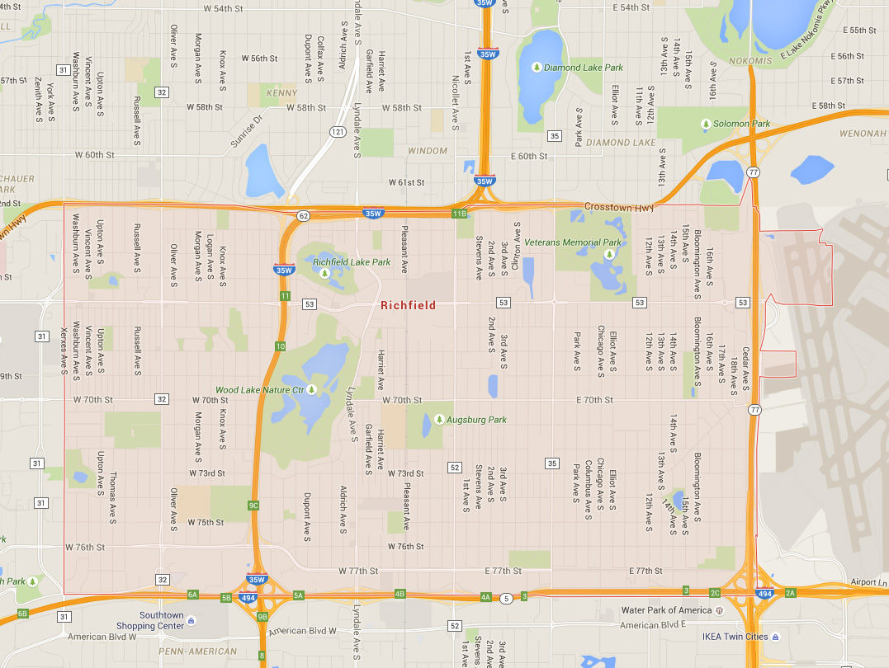
What is a Suburb?
Scott W. Allard – Places in Need

Slide 5
What is a Suburb?
No formal definition
More than geography
Social and demographic
Different questions = different definitions
Not likely to settle on one definition
Must understand assumptions of any definition
Scott W. Allard – Places in Need

Slide 6
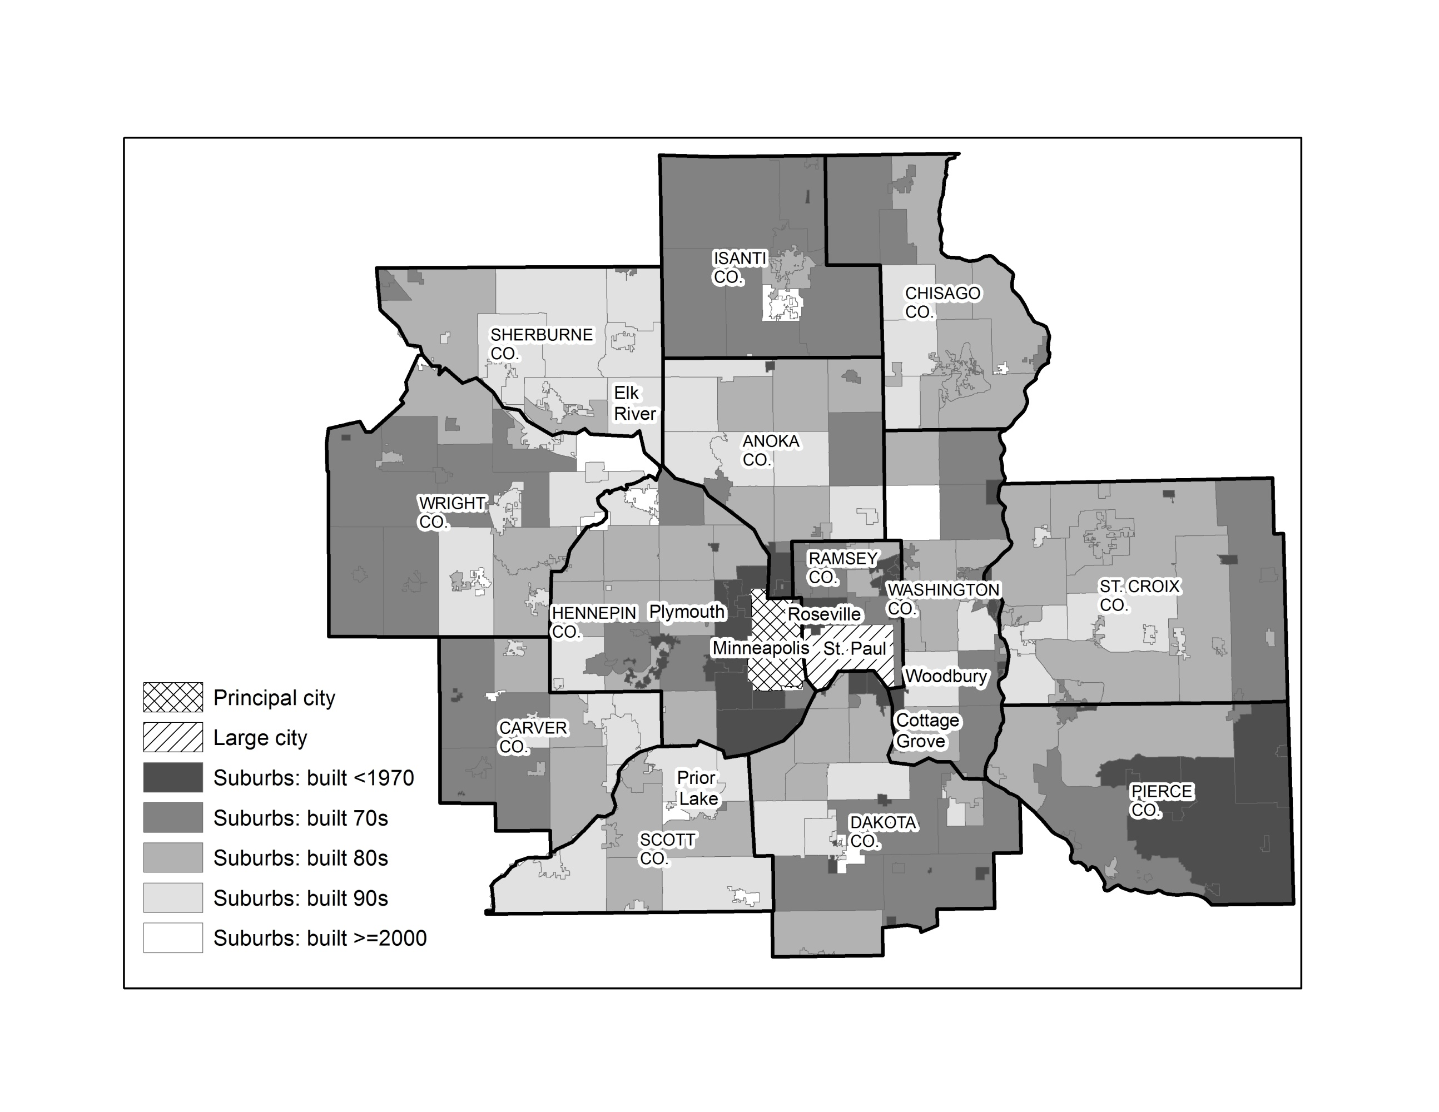
Defining Suburbs in the Minneapolis-St. Paul Metro Area

Slide 7
Poverty, Place, and Race

Slide 8
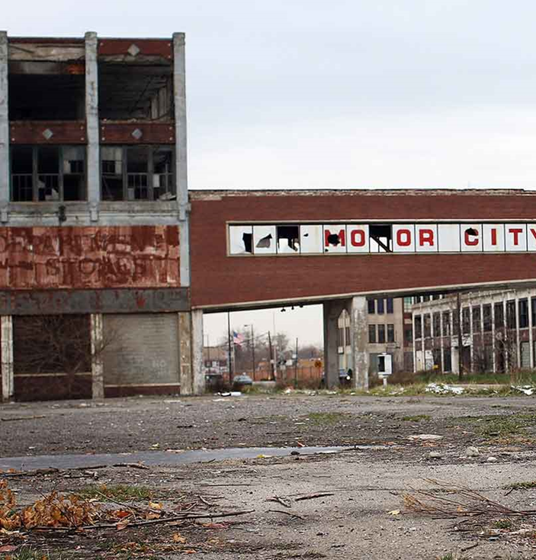
Conventional Thinking about
Place & Poverty
Poverty is viewed largely as an urban phenomenon
Urban settings common in images and language around poverty
Notions of poverty causes and deservingness are tied to urban places

Slide 9
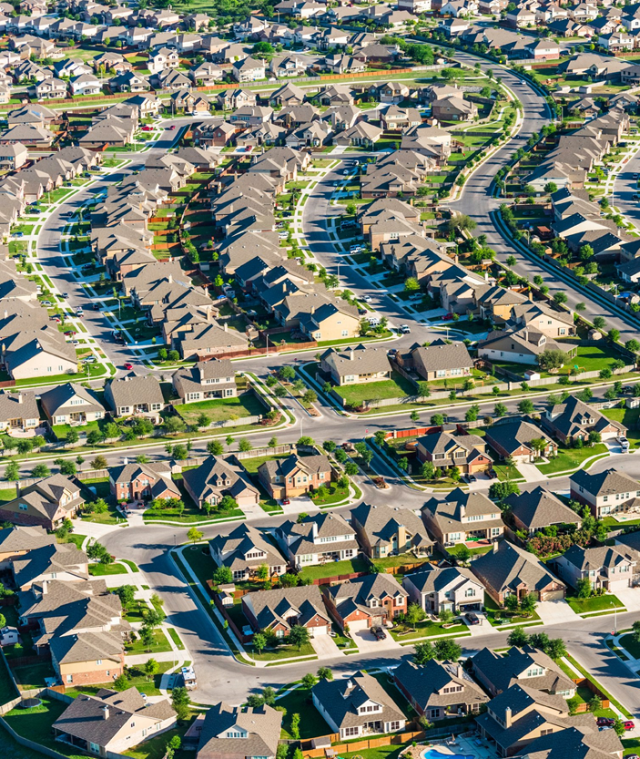
Conventional Thinking about
Place & Poverty
Suburbs are perceived to be places of affluence
Suburbs embody the American dream
Symbolize normative behavior around work and family

Slide 10
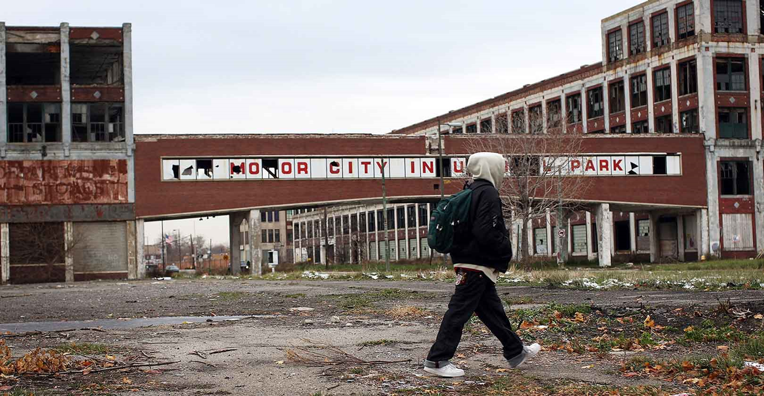
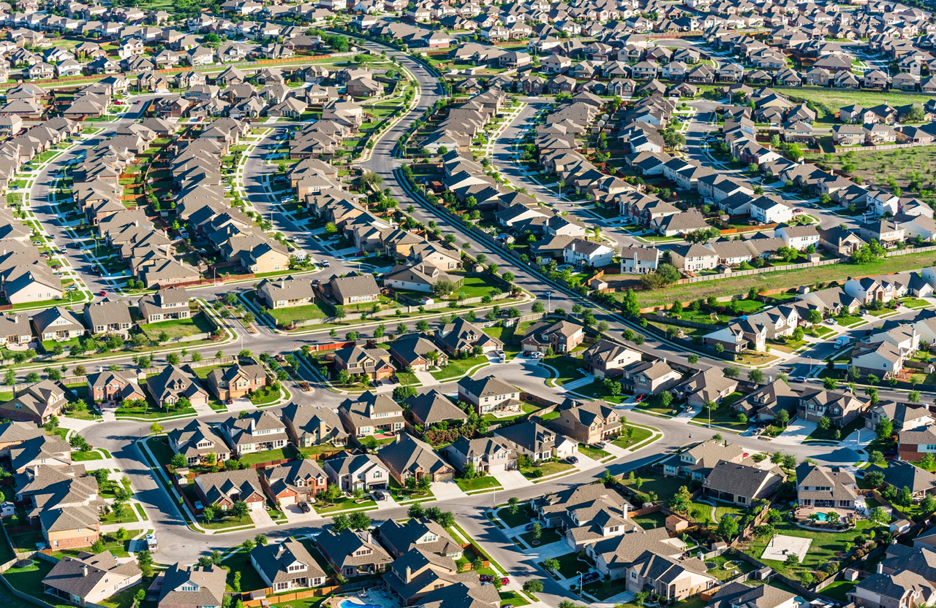
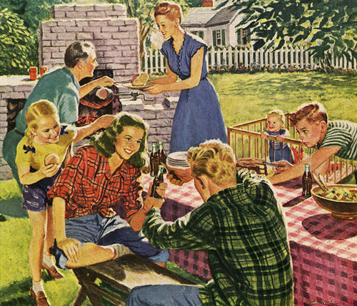
Conventional Thinking about
Place & Poverty
Conventional Thinking about
Place & Poverty
Poverty in urban spaces often is explicitly linked to communities of color
Suburbs are perceived to be places of affluence
Suburbs embody the American dream
Symbolize normative behavior around work and family
Suburban living often is explicitly linked to whiteness

Slide 11
“[suburban municipality] is urban . . . if you look at the education, it’s definitely urban education [in this suburban municipality] . . . . urban education is having to spend probably a disproportionate amount of time looking at specific issues. One is dealing with poverty and the disadvantages that poverty brings to the community . . . people who are poor don’t have the money to do the extras that those kids . . . They don’t have books, they don’t have material . . . that goes hand in hand with the other issue, which I feel goes closely with urban education, which is lack of parent education.”
-Regional Nonprofit Executive Director
Scott W. Allard – Places in Need

Slide 12
Conventional Thinking about Place & Poverty
Number of mentions in JSTOR academic journal articles
Poverty research is focused on urban spaces and settings
Scott W. Allard – Places in Need

Slide 13
Conventional Thinking about Place & Poverty
Poverty problems are more acute within cities & communities of color
But, the conventional discourse:
Overlooks substantial need & depth of poverty in all places
Promotes biased understandings of poverty
Fosters notion poverty is a problem “others” experience
Leaves responsibility to address poverty problems to others
Undermines public support for safety net investments
Fails to grasp complexity of need & human service provision
Scott W. Allard – Places in Need

Slide 14
Discussion: How do these stereotypes appear in your work?

Slide 15
Suburbanization of Poverty – Top 100 Metros
Number of Poor People (1,000s)
Sources: Census 1990, 2000; American Community Survey, 2006-10, 2010-14, 2013-17.
Scott W. Allard – Places in Need

Slide 16
Suburbanization of Poverty – Top 100 Metros
About 4 million more poor people in the suburbs of largest metros in 2017, than in cities
Number of Poor People (1,000s)
Sources: Census 1990, 2000; American Community Survey, 2006-10, 2010-14, 2013-17.
Scott W. Allard – Places in Need

Slide 17
Suburbanization of Poverty – Top 100 Metros
Tipping point nationally occurred about 20 years ago
Number of Poor People (1,000s)
Sources: Census 1990, 2000; American Community Survey, 2006-10, 2010-14, 2013-17.
Scott W. Allard – Places in Need

Slide 18
Suburbanization of Poverty – Top 100 Metros
Suburban poverty quite prevalent back in 1980s and early 90s
Number of Poor People (1,000s)
Sources: Census 1990, 2000; American Community Survey, 2006-10, 2010-14, 2013-17.
Scott W. Allard – Places in Need

Slide 19
Suburbanization of Poverty – Top 100 Metros
Number of poor people in suburbs has grown at 3x the rate of population growth
Number of Poor People (1,000s)
Sources: Census 1990, 2000; American Community Survey, 2006-10, 2010-14, 2013-17.
Scott W. Allard – Places in Need

Slide 20
Suburbanization of Poverty – Top 100 Metros
Poverty problems persist near historic levels in cities
Number of Poor People (1,000s)
Sources: Census 1990, 2000; American Community Survey, 2006-10, 2010-14, 2013-17.
Scott W. Allard – Places in Need

Slide 21
Poverty Rates – Urban, Suburban and Rural
Scott W. Allard – Places in Need

Slide 22
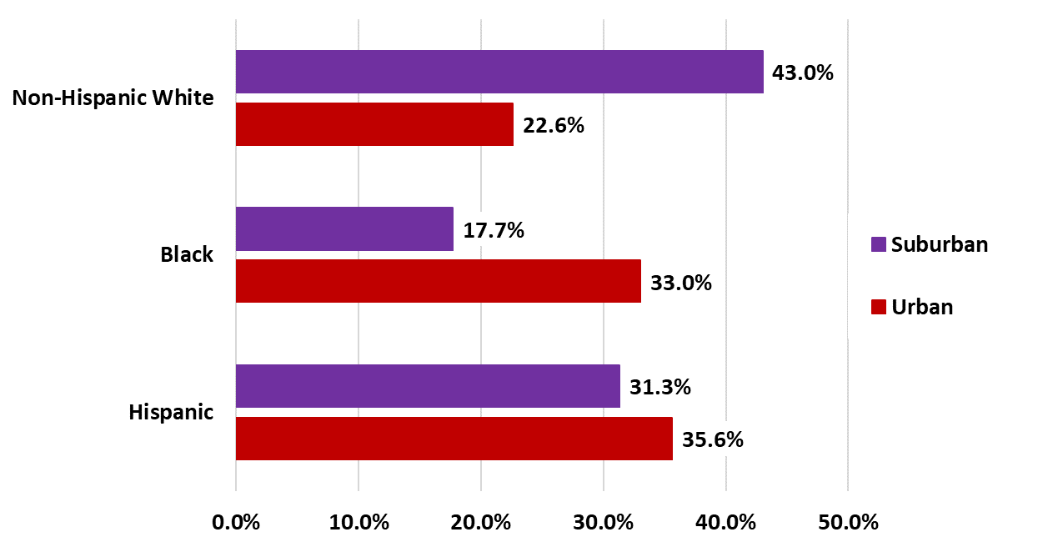
Place, Race, and Poverty
Nationally, non-Hispanic Whites are near-majority of the poor in suburbs
Black and Hispanics compose about 2/3 of the urban poor
Urban poor – particularly poor people of color - segregated in highest poverty neighborhoods
Concentrated poverty is a suburban reality for all race and ethnic groups
Race and Ethnic Composition of Poor Population in Largest 100 Metro Areas
Source: American Community Survey, 2010-14.
Scott W. Allard – Places in Need

Slide 23
What Has Happened in Wisconsin?

Slide 24
Geography of Poverty in Wisconsin
Number of Poor People (1,000s)

Slide 25
Geography of Poverty in Wisconsin
Number of Poor People (1,000s)

Slide 26
Geography of Poverty in Wisconsin
Number of Poor People (1,000s)

Slide 27
Poverty Rates in WI – Urban, Suburban & Rural
Scott W. Allard – Places in Need

Slide 28
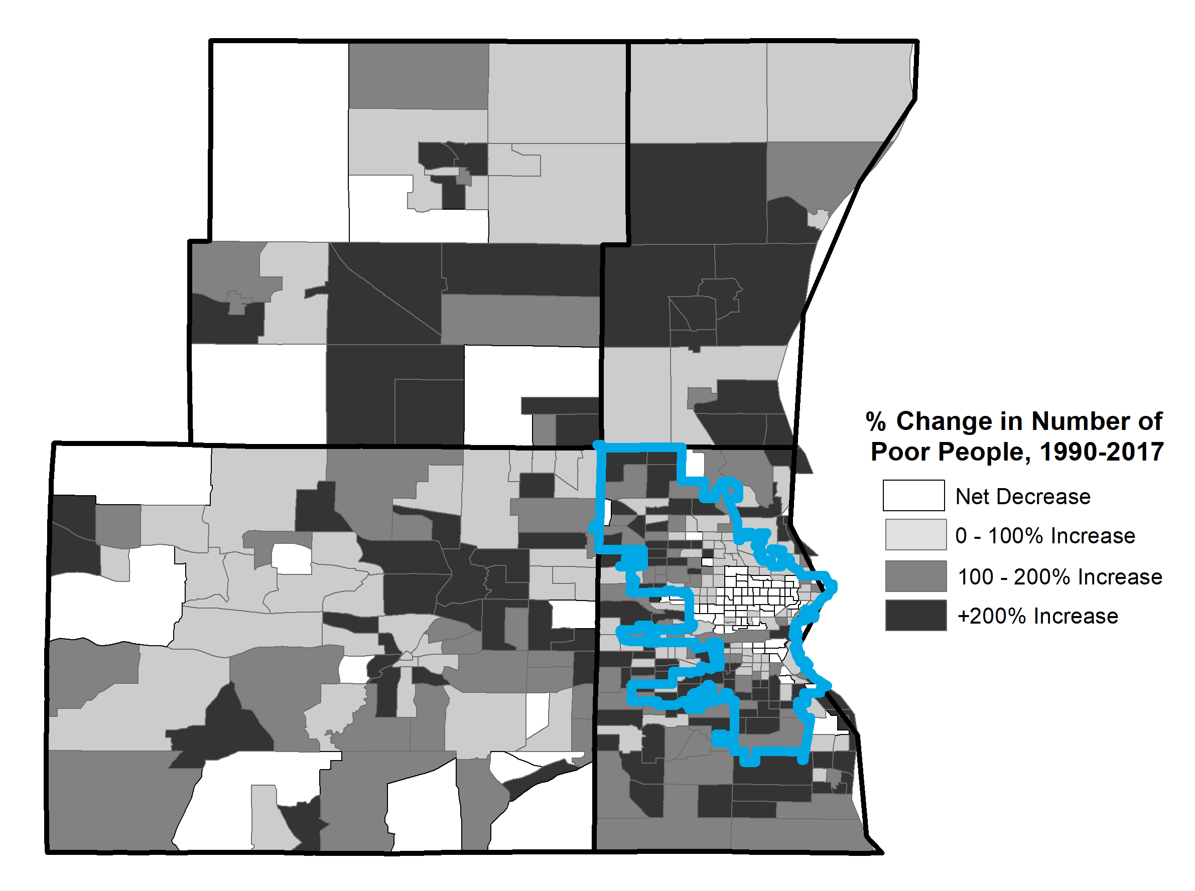
Suburbanization of Poverty – Milwaukee Metro
Washington County
Suburb | % Change in Population 1990-2017 | % Change in Number of Poor People 1990-2107
Brookfield | 9.2% | 233.8%
Germantown | 45.1% | 134.4%
Greenfield | 11.0% | 186.6%
Menomonee Falls | 35.0% | 87.2%
New Berlin | 22.2% | 148.2%
Waukesha | 16.1% | 118.1%
Wauwatosa | -3.3% | 115.2%
West Allis | -4.4% | 145.1%
Ozaukee County
Waukesha
County
City of Milwaukee
Milwaukee County
Sources: Census 1990, 2000; American Community Survey, 2006-10, 2010-14, 2013-17.

Slide 29
What Explains these Trends in Place & Poverty?
Structural economic changes
Deindustrialization and loss of manufacturing jobs
Much of job growth is in lower-wage jobs
Returns to college education or advanced training
Lingering impact of Great Recession – jobs, earnings, and housing
Immigration to suburban destinations
Migration from rural areas and cities
Increases in share of single-parent households
Scott W. Allard – Places in Need

Slide 30
Discussion: What are the implications of these shifts in poverty for your communities and programs?

Slide 31
Discussion: Questions about the data?

Slide 32
Implications for Safety Net & Policy
Highlights the inherent localness of human services
Insufficient capacity, resources, partners and referrals
Limited capacity and funds – public & private
Fragmentation & distance
Few economies of scale
Competitive pressures & NIMBYism
Perception gaps & “othering” of the poor
Discrimination & anti-immigrant sentiment

Slide 33
Safety Net Overview
Core Public Assistance Programs
Earned Income Tax Credit (EITC), Supplemental Nutrition Assistance Program (SNAP), Medicaid, Temporary Assistance for Needy Families (TANF)
Community-based Nonprofits (≈$100 billion/yr)
Emergency assistance, housing, education, employment, behavioral health
Publicly funded, delivered primarily through community-based organizations
Place-based Programs
Harlem Children’s Zone and Promise Neighborhoods
Opportunity Zones, Empowerment Zones, and Tax Incentives
Decentralized Antipoverty Safety Net
Availability varies by program – federal/state policy, local resources, political will, philanthropy

Slide 34
Safety Net Response: Earned Income Tax Credit
Median EITC Return or Credit in 2014
($2015)
EITC Refunds and Credits are nearly identical across geography
Sources: 2010-14 American Community Survey; Brookings Institution 2015; U.S. Census Bureau 2015.
Scott W. Allard – Places in Need

Slide 35
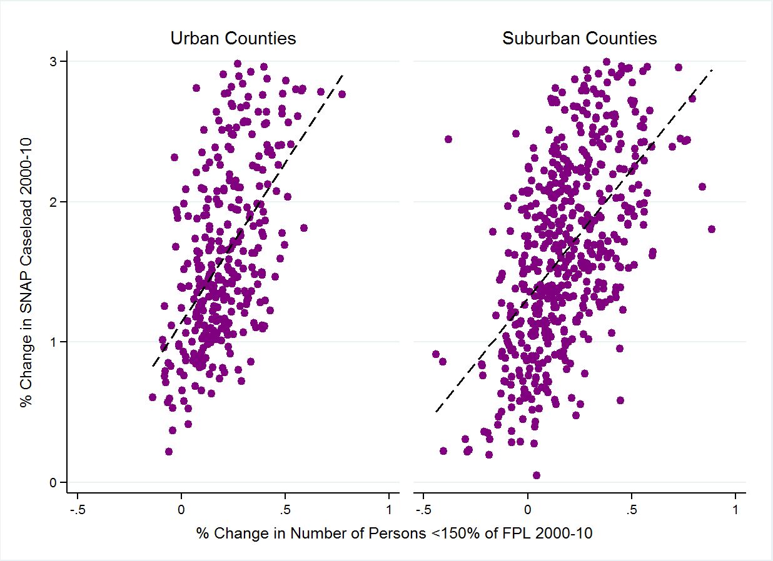
Safety Net Response: SNAP
SNAP Caseloads respond consistently to changes in the number of low-income people
SNAP Caseload responds similarly to need across geography
% Change in SNAP Recipients, 2000-10
% Change in Number of People with Income <150% FPL, 2000-10
Sources: 2000 Census; 2006-10 American Community Survey; U.S. Census Bureau, SNAP Benefits Recipients, Small Area Income and Poverty Estimates 2015.
Scott W. Allard – Places in Need

Slide 36
Safety Net Response: Nonprofit Human Services
Median Nonprofit Expenditures Per person <150% FPL in 2015
There are large gaps in human service provision by geography
WI shows evidence of greater spatial parity due to greater public funding
Sources: 2013-17 American Community Survey; National Center for Charitable Statistics.

Slide 37
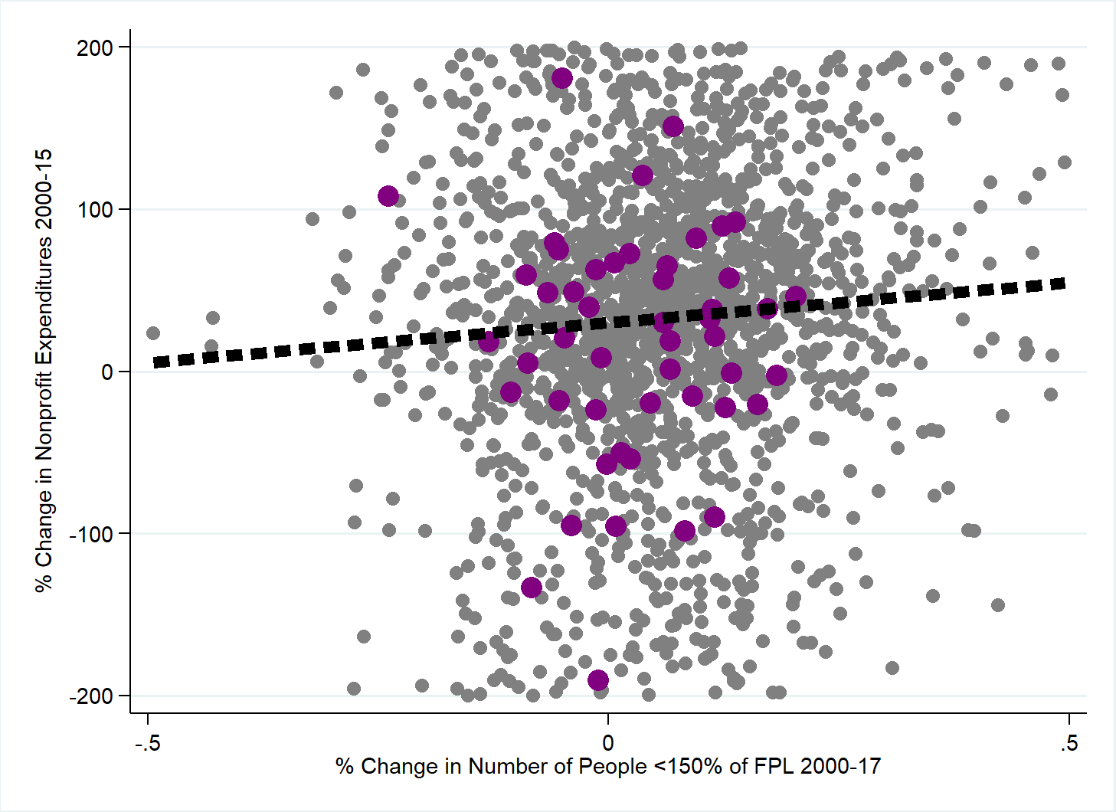
Safety Net Response: Nonprofit Human Services
Nationally, nonprofit human service provision is only weakly responsive to changes in need
- Counties in U.S.
- Counties in WI
Scott W. Allard – Places in Need

Slide 38
Safety Net Response: Nonprofit Human Services
Nonprofit human service provision appears less responsive to changes in need in Wisconsin
- Counties in U.S.
- Counties in WI
Scott W. Allard – Places in Need

Slide 39
Discussion: How does this evidence challenge conventional wisdom in our communities?

Slide 40
What is Working?
Building awareness and support among state/local elected officials
Expanding public investments & private philanthropy
Supporting culturally competent practice
Tapping into communities of faith
Finding small collaborations on which to build
Investing in convenings, dialogue, and coordination

Slide 41
What is Our Work?
Challenge stereotypes about poverty and its causes
Greater and more consistent federal funding
What kinds of place-based anti-poverty and economic development programs “work”?
Expand private philanthropy – new giving, better targeting
Better data and translation of research to policy
Train the next generation of local leaders
Choosing a shared fate

Slide 42
What will you do? What will we do together?

Slide 43
Scott W. Allard
Daniel J. Evans Endowed Professor
of Social Policy
Evans School of
Public Policy & Governance
University of Washington
sallard@uw.edu
@scottwallard
www.scottwallard.com
Thank you!!!!

